Slide 1

WATER QUALITY PREDICTION
PRESENTED BY:
N. Joshna 19471A05H1
CH. Ramoji 19471A05D7
K. Pravallikha 19471A05F4
GUIDE:
Dr. B. Jhansi Vazram, M.Tech, Ph.D.

Slide 2
CONTENTS
ABSTRACT
LITERATURE SURVEY
REQUIREMENTS
CONCLUSION

Slide 3
ABSTRACT
Predicting portable water quality is more effective for water management and water pollution prevention.
Predicting the quality of drinkable water may reduce the incidence of water-related diseases.
Several parameters were used to predict the quality of the water.
Different machine learning algorithms were used to determine water quality
for drinking.
It helps to humans for identifying quickly whether the water is drinkable or not.

Slide 4
LITERATURE SURVEY
This research explores the methodologies that have been employed to help solve problems related to water quality. The main objective of the project is to predict reasonable accuracy using required number of parameters to validate the possibility of its use in real time water quality detection systems. This research explores a series of supervised machine learning algorithms to estimate the water quality index.

Slide 5
REQUIREMENTS
Software Requirements:
Browser : Any latest browser like Chrome
Operating System : Windows 10
Language : Python
Platform : Jupyter
Hardware Requirements:
Intel CORE : i5 or i7
RAM : 8GB
System type : 64-bit operating system

Slide 6
PROPOSED SYSTEM
Based on the problems of predicting quality of water for drinking
The main task was to find out which factor would give a good indication of the quality of the water.
Hardness, sulfate, solid, trihalomethanes, pH, turbidity, solids, organic carbon, and conductivity were chosen as parameters.
The collective behavior of the parameters to produce a legitimate output, which will determine if the water is potable or not.
The proposed method of the project is explained in different steps.

Slide 7
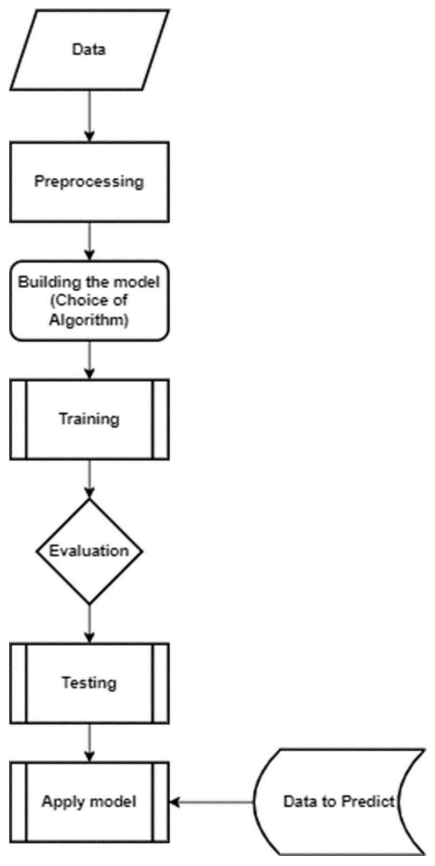
System Architecture

Slide 8
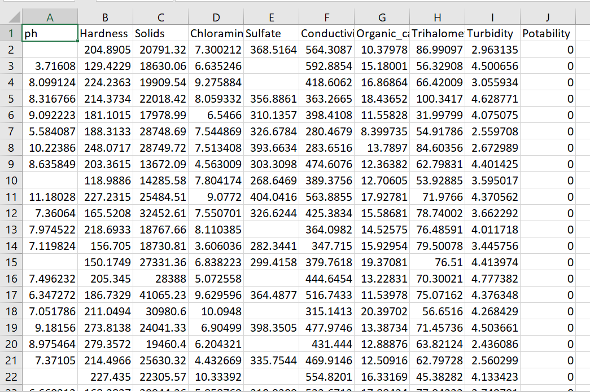
Dataset

Slide 9
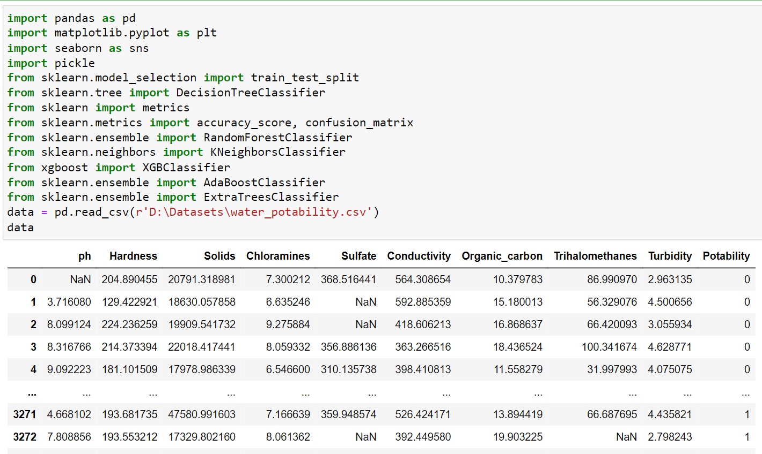
Importing and reading the dataset

Slide 10
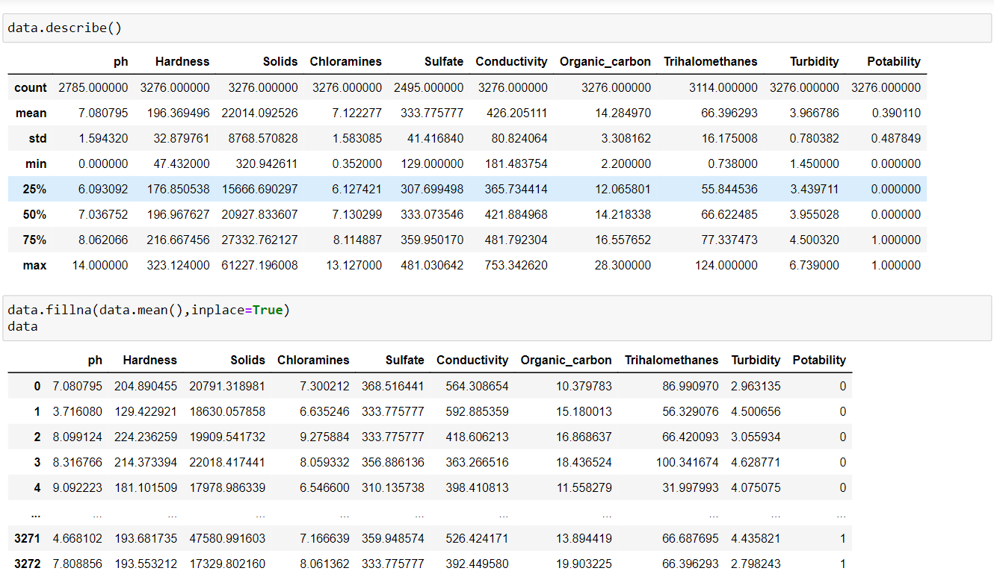
Filling null values

Slide 11
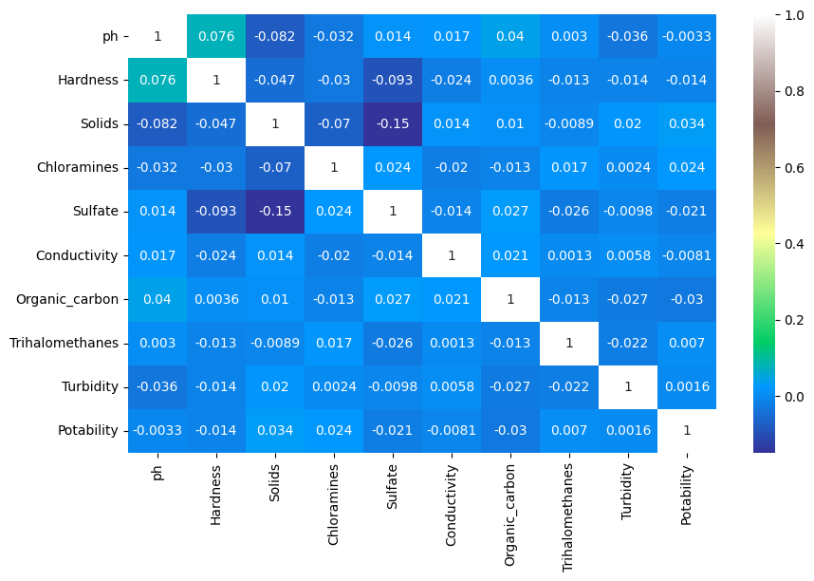
Correlation between the parameters

Slide 12
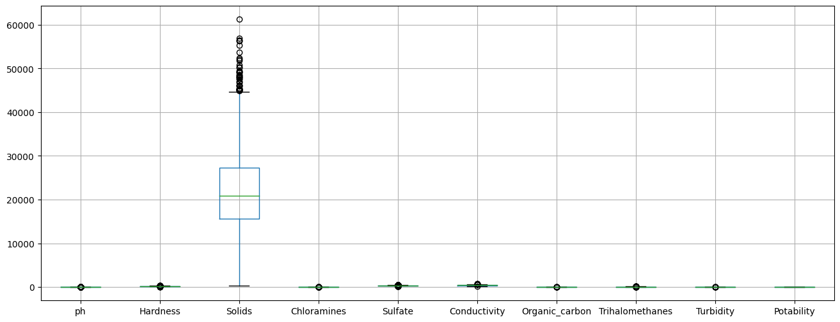
Outliers

Slide 13
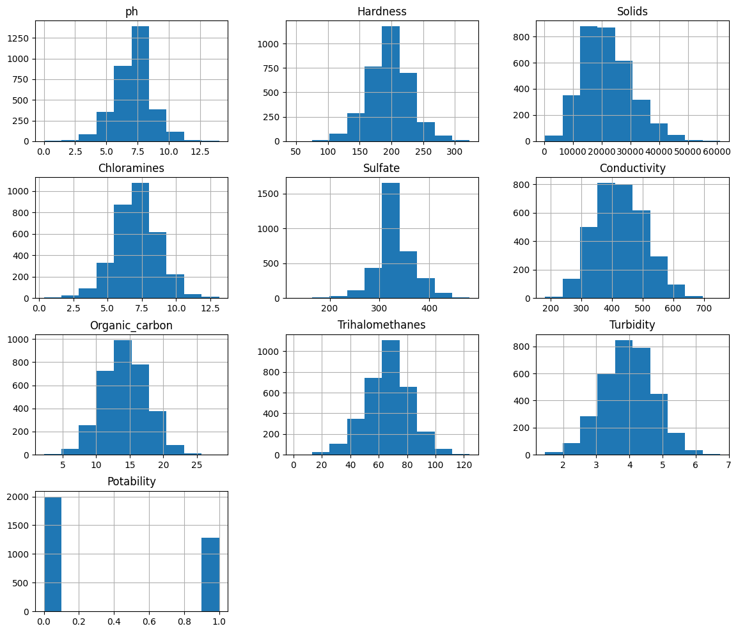
Normal Distribution

Slide 14
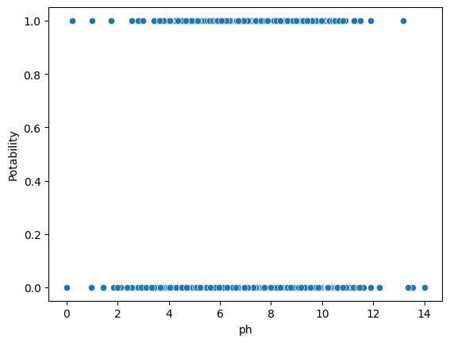
Scatterplot between pH and potability

Slide 15
MACHINE LEARNNING ALGORITHMS:
Algorithm | Accuracy
Decision Tree | 62.04%
Kneighbors Classifier | 61.12%
Extreme Gradient Boosting | 64.94%
Adaptive Boosting | 64.02%
Support Vector Machine | 62.80%
Random Forest | 69.66%
Extra Trees Classifier | 69.81%

Slide 16
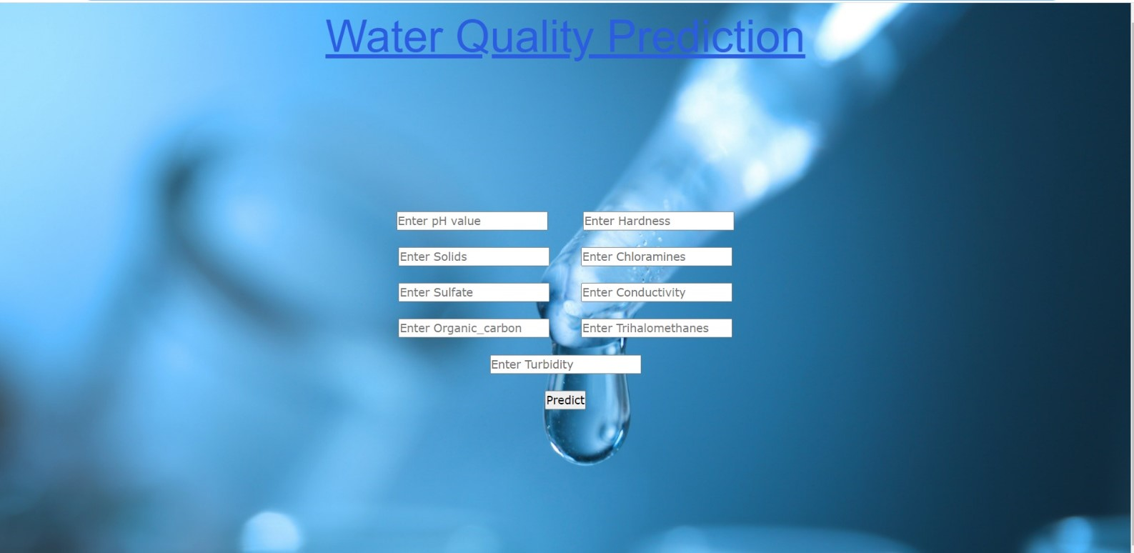
OUTPUT SCREENS

Slide 17
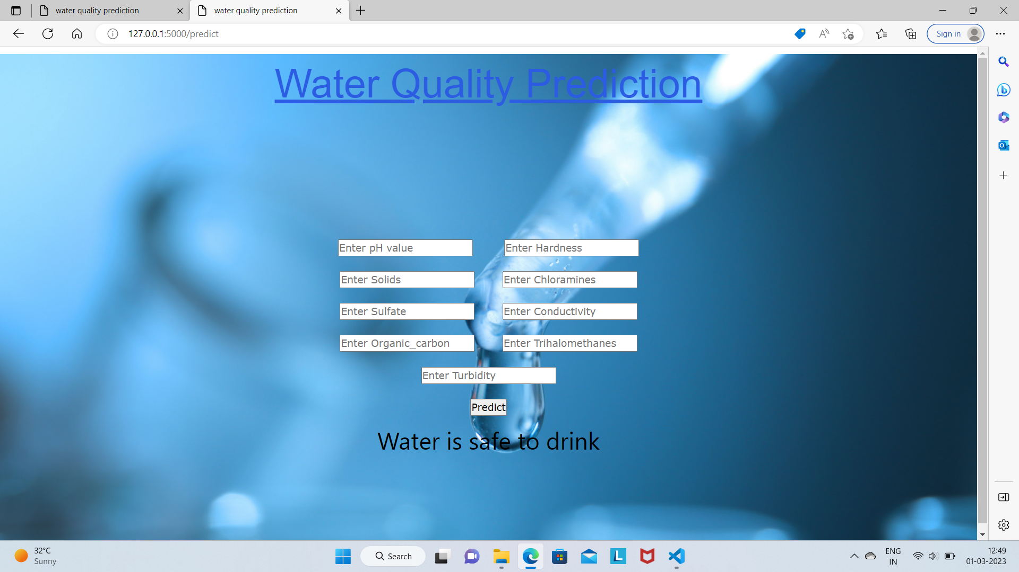
Water is Safe

Slide 18
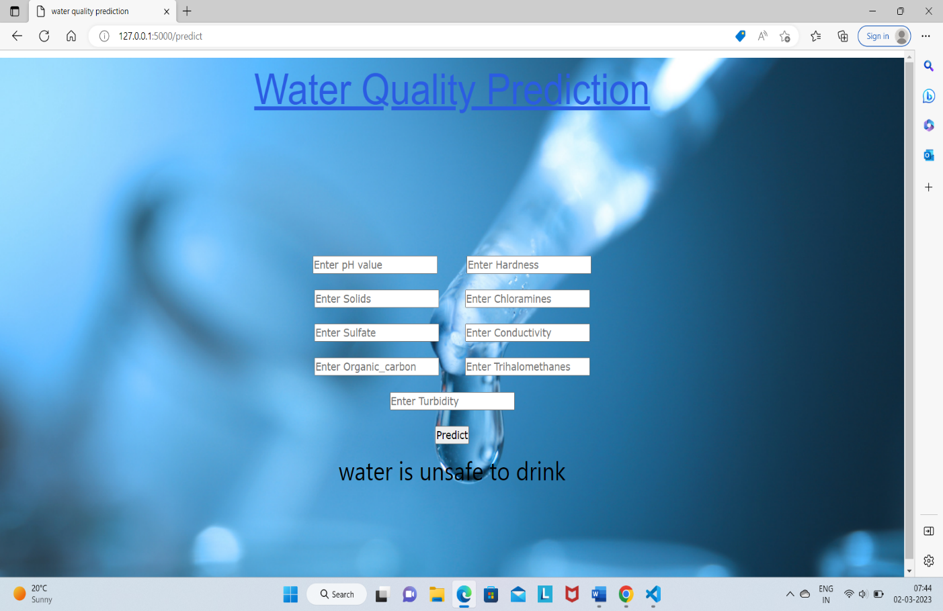
Water is unsafe

Slide 19
CONCLUSION Water is one of the most essential resources for survival and its quality is determined through water quality index. This research explored an alternative method of machine learning to predict water quality using minimal and easily available water quality parameters. A set of representative supervised machine learning algorithms were employed to estimate water quality index and also predicted and classified more efficiently. It would identify poor quality water before it is released for consumption. Different types of algorithms were used to predict the quality of water.

Slide 20
THANK YOU

